Slide 1




BizBook (Vocal for Local Concept)
KRUPAL MEHTA (92400584065)
SHYAM HUMBAL (92400584084)
DIVYESH GONDALIYA (92400584068)
Guide: Dr. Jaypalsinh Gohil

Slide 2

CONTENTS
1. Introduction to Project Definition
2. PREAMBLE
3. REVIEW OF LITERATURE
4. TECHNICAL DESCRIPTION
5. SYSTEM DESIGN AND DEVELOPMENT
6. SYSTEM TESTING
7. CONCLUSION
8. LEARNING DURING PROJECT WORK
9. BIBLIOGRAPHY

Slide 3

01
Introduction to Project Definition

Slide 4

Project Overview
Project Title: BizBook (Vocal for Local)
Technology Stack: MERN (MongoDB, Express.js, React.js, Node.js)
Type: Web-based Appointment & Order Booking Platform
Client: Public users (customers) + Admin Panel (for business management)
Domain: Local Business Service Platform
Synopsis:
BizBook (also called Local for Vocal) is a full-stack web application built using the MERN stack that helps local businesses connect with users digitally. The platform allows users to discover nearby businesses like salons, restaurants, cafes, or retail stores and make appointments, table bookings, or product orders directly through the app.
Admins can manage businesses, products/services, and categories through a secure backend panel. The system smartly handles different types of businesses based on category logic – such as appointments for salons, table bookings for restaurants, and product orders for retail shops.

Slide 5





Project Description
In today’s digital age, many local businesses still rely on walk-in customers or phone calls. BizBook helps modernize that by creating a smart online presence for these businesses. It acts like a mini local version of Google Maps + UrbanClap + Zomato, where users can:
1
Browse verified businesses
2
View their services or products
3
Make appointments or place orders
4
Track their bookings
Each business belongs to a category such as:
1
Salon / Doctor – takes Appointments
2
Restaurant / Café – supports Table Bookings
3
Retail / Grocery – handles Product Orders (without delivery for now)

Slide 6

02
PREAMBLE

Slide 7


Module Description
1. User Module
Register/Login with JWT-based session
View all businesses
View business details (services/products)
Book appointment, table, or order based on category
View all their bookings
Frontend built in React with axios, routing, and session logic
2. Admin Module
Secure login for admin (handled on EJS panel)
Dashboard view: total businesses, services, appointments
Add/manage businesses
Add/manage products or services for each business
View and manage user appointments
Admin routes protected and organized using Express.js
3. Business Module
Add new business (via Admin)
Each business has:
Name, Description, Category
Address, Phone, Map link, Social Media
Category determines how booking works (appointment/order/table)
Businesses are shown with clean cards on frontend

Slide 8
4. Product/Service Module
Each product/service is linked to a business
Added via admin panel
Shown in detail on business page
Used during appointment or product order flow
Supports price, description, and image fields
5. Booking/Appointment Module
Users can make appointments/orders/bookings
Logic based on business category:
Salon = time-based appointment
Restaurant = date + time + number of people (table booking)
Retail = simple product order (no delivery)
Stored in MongoDB with relation to User & Business
Admin can view all bookings in panel
6. Category Module
Predefined business types:
Salon, Restaurant, Café, Grocery, Doctor, etc.
Each category has a booking type:
Appointment, Table, or Order
Used to drive logic in both backend & frontend
Admin can fetch categories for dropdowns

Slide 9

03
REVIEW OF LITERATURE

Slide 10
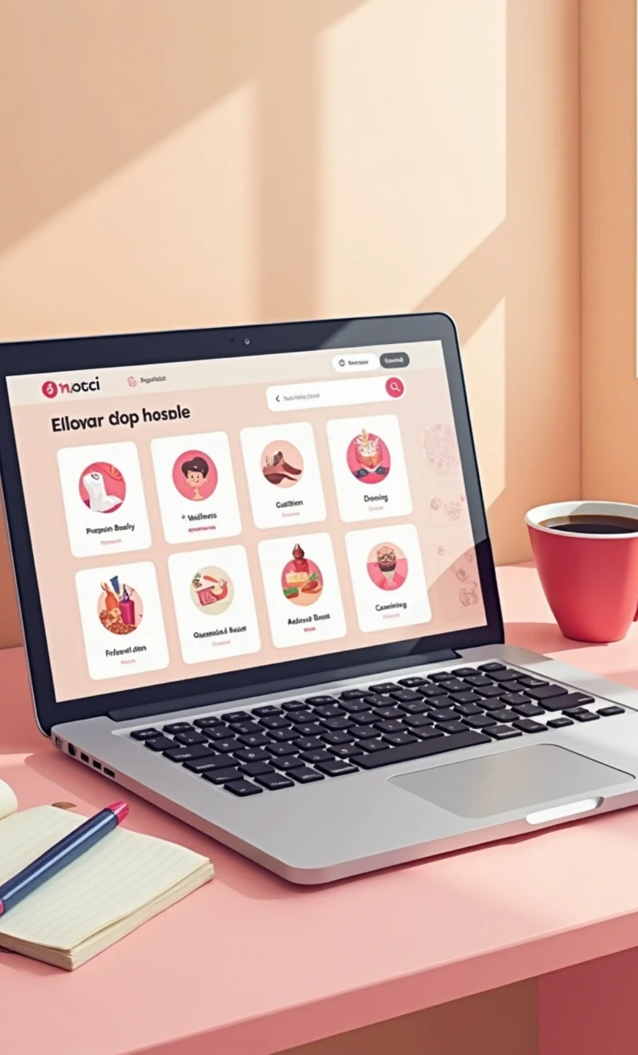
REVIEW OF LITERATURE
To better understand and position BizBook, a study was conducted on similar platforms that allow users to discover and book local services or products. The following systems were reviewed:

Slide 11

UrbanClap
Functionality: Offers appointment-based services such as salon, repair, cleaning, and more.
Technology: Uses a mobile-first approach with robust backend services.
Learning: Emphasis on category-specific booking flows and service provider profiles.

Slide 12

Justdial
Functionality: Directory-style listing of businesses with user reviews, contact info, and basic inquiry features.
Learning: Strong search engine and categorization helped understand listing dynamics.

Slide 13

Zomato
Functionality: Focused on restaurants with menu display, booking table or ordering food.
Learning: Product-based and table booking logic were well implemented, influencing BizBook’s dual booking types.

Slide 14


Booksy
Functionality: Salon and wellness booking app with time slots and user profiles.
Learning: Gave insights into appointment scheduling UX and availability logic.
Major Findings
1
A successful system integrates category-wise logic for booking: appointment, table, or product order.
2
Admin control over business listings and services is essential for data integrity.
3
Role-based access improves security and functionality separation.
4
Real-time appointment availability, feedback, and booking confirmation mechanisms are essential features.

Slide 15

04
TECHNICAL DESCRIPTION

Slide 16
Hardware Requirements
Component | Specification
Processor | Intel Core i5 or above
RAM | Minimum 8 GB
Hard Disk | Minimum 256 GB SSD or 500 GB HDD
Display | 14” or higher, 1366x768 resolution or more
Network | Internet connection (for API/database)

Slide 17
Software Requirements
Frontend | React.js, Axios, Tailwind CSS
Backend | Node.js, Express.js
Database | MongoDB
Admin Panel | EJS Templates with Express.js
Authentication | JWT
Operating System | Windows 10 / 11 or Linux (Ubuntu)
Version Control | Git & GitHub
Development Tools | VS Code, Postman, MongoDB Compass
Hosting | Render / Vercel / Netlify (Frontend), Render

Slide 18
05
SYSTEM DESIGN AND DEVELOPMENT

Slide 19
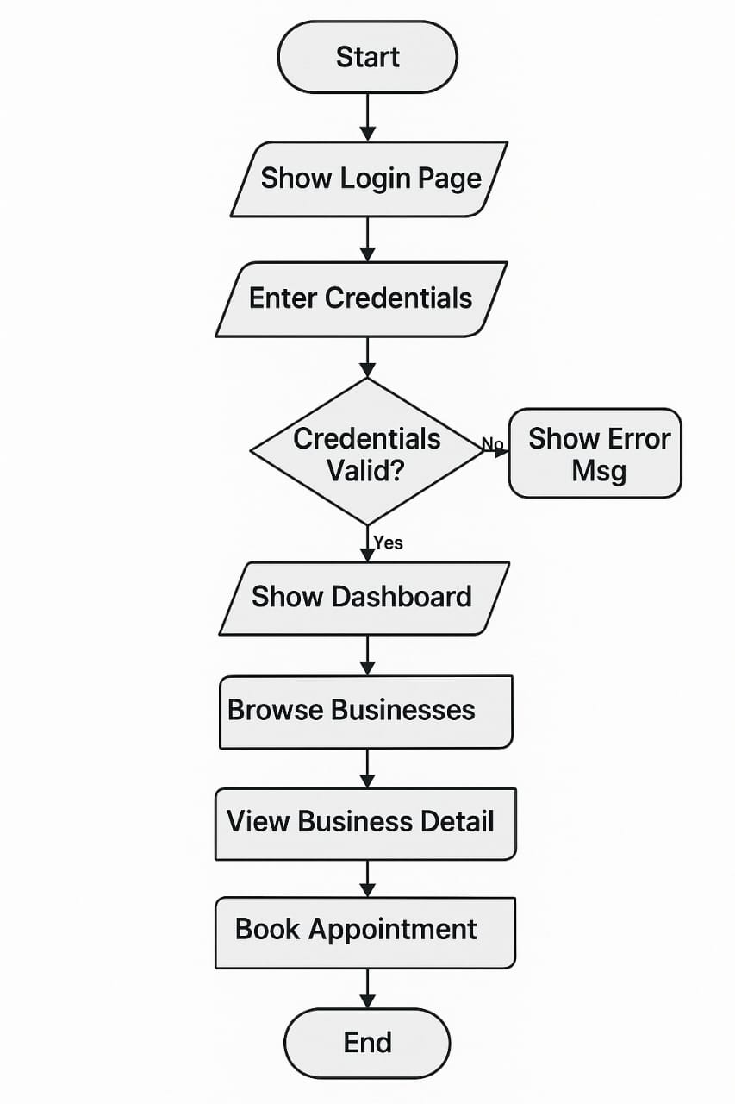
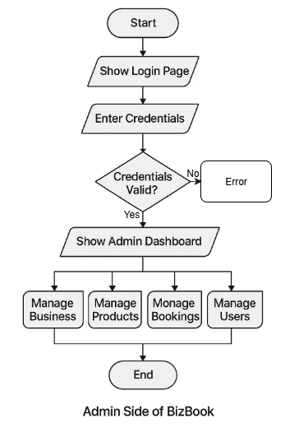
Diagrams
Flow Chart: Admin
Flow Chart Diagram: Client

Slide 20
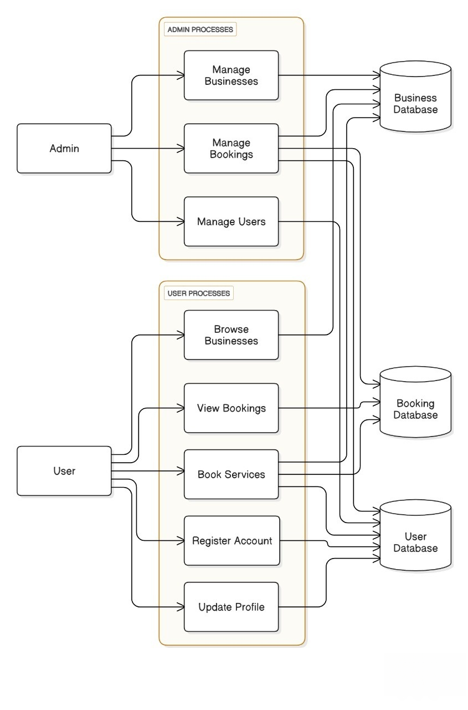
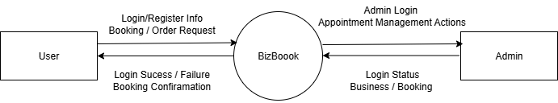
DFD: Level 0
DFD: Level 1

Slide 21
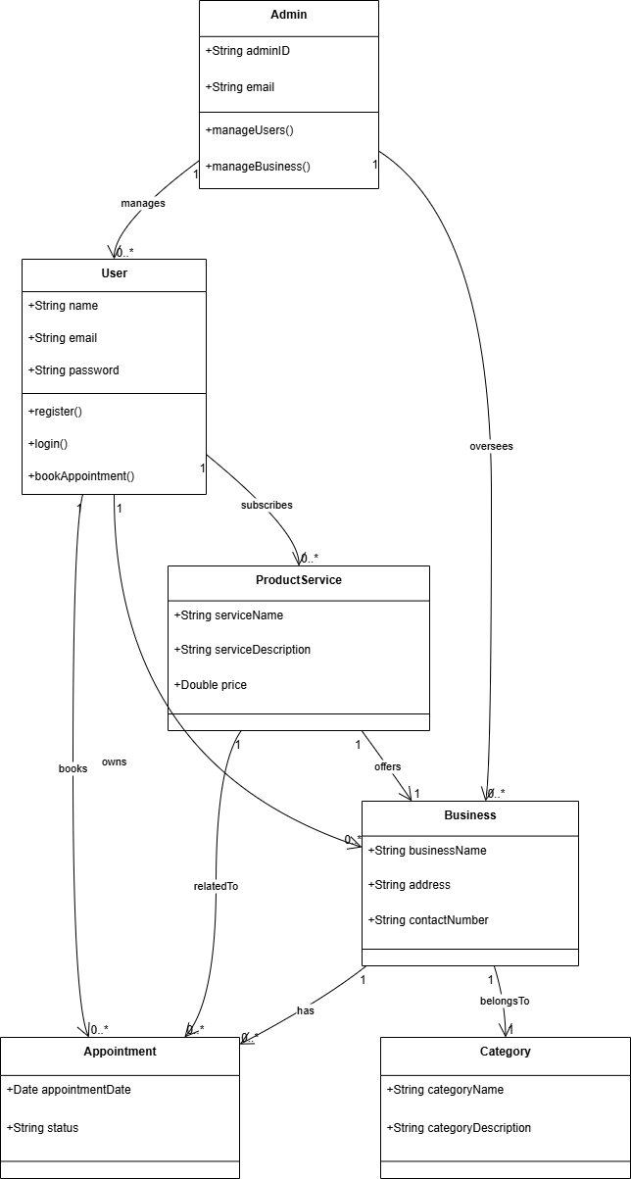
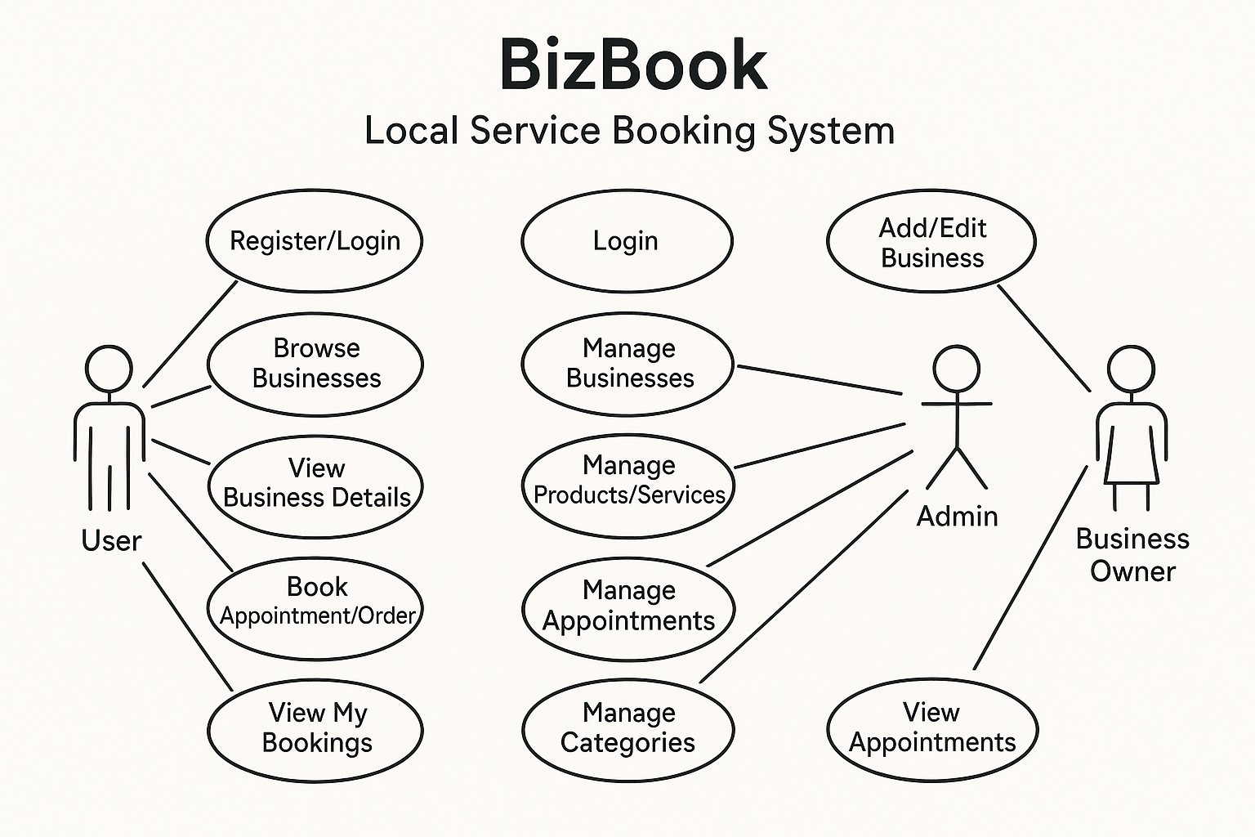
Class Diagram
Use Case Diagram

Slide 22
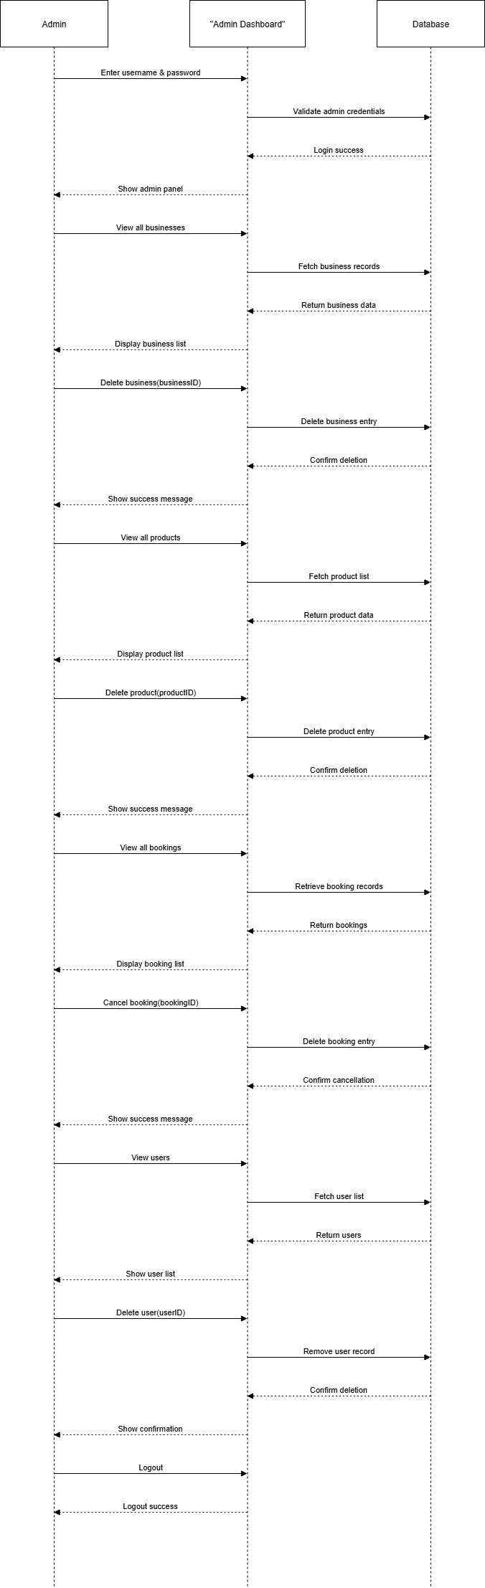
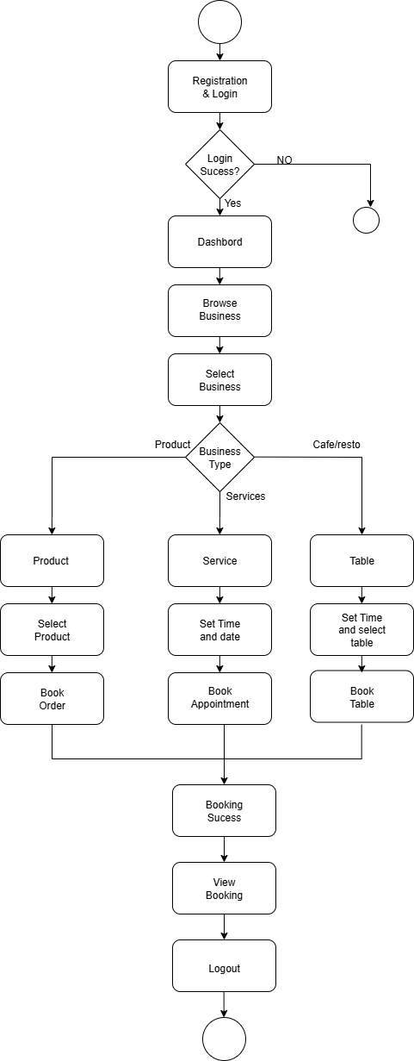
Sequential Diagram
Activity Diagram: Client side

Slide 23
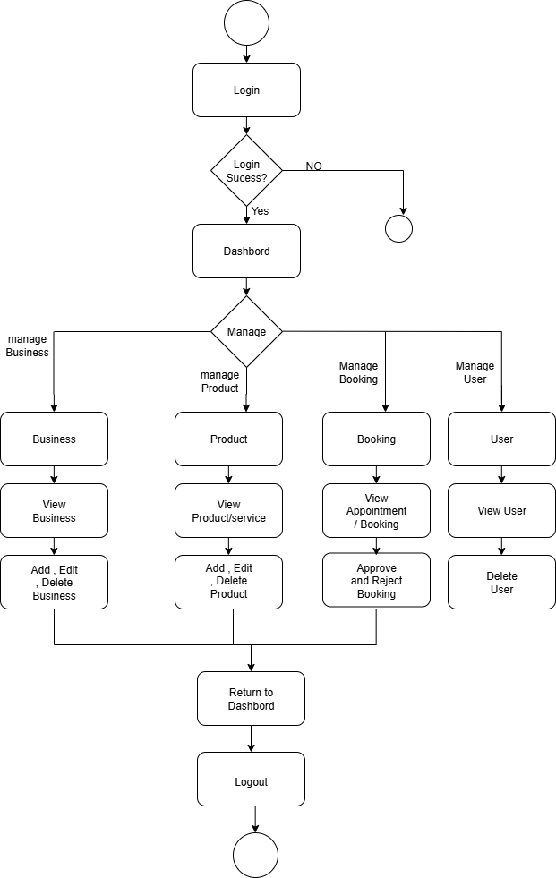
Activity Diagram: Admin Side

Slide 24

Database Design
1. User Collection
Stores all user details including registered clients and role-based access.
Field | Type | Description
_id | ObjectId | Unique identifier (automatically generated)
name | String | Full name of the user
email | String | User's email (must be unique)
password | String | Hashed password
phone | String | Contact number
role | String | user or admin
createdAt | Date | Registration date
2. Business Collection
Represents businesses listed on the platform (e.g., salons, restaurants).
Field | Type | Description
_id | ObjectId | Unique identifier
name | String | Business name
email | String | Business contact email
phone | String | Business phone number
address | String | Full address
description | String | Short description or about section
category | ObjectId | FK reference to Category collection
createdAt | Date | Timestamp of addition

Slide 25
3. Category Collection
Predefined categories with booking logic (appointment/order/table).
Field | Type | Description
_id | ObjectId | Unique identifier
name | String | e.g., Salon, Restaurant, Retail Store
type | String | appointment, table, or order
4. Product/Service Collection
Stores services or products offered by businesses.
Field | Type | Description
_id | ObjectId | Unique identifier
name | String | Name of product/service
description | String | Details about the product/service
price | Number | Price in INR or other local currency
businessId | ObjectId | FK reference to Business collection
createdAt | Date | Timestamp of creation
5. Booking Collection
Captures user bookings or product orders based on category type.
Field | Type | Description
_id | ObjectId | Unique identifier
userId | ObjectId | FK to User collection
businessId | ObjectId | FK to Business collection
productId | ObjectId | FK to Product/Service (optional)
date | String | Date of booking (YYYY-MM-DD format)
time | String | Time of appointment (if applicable)
type | String | appointment, table, or order
status | String | pending, confirmed, completed
createdAt | Date | Timestamp of booking

Slide 26

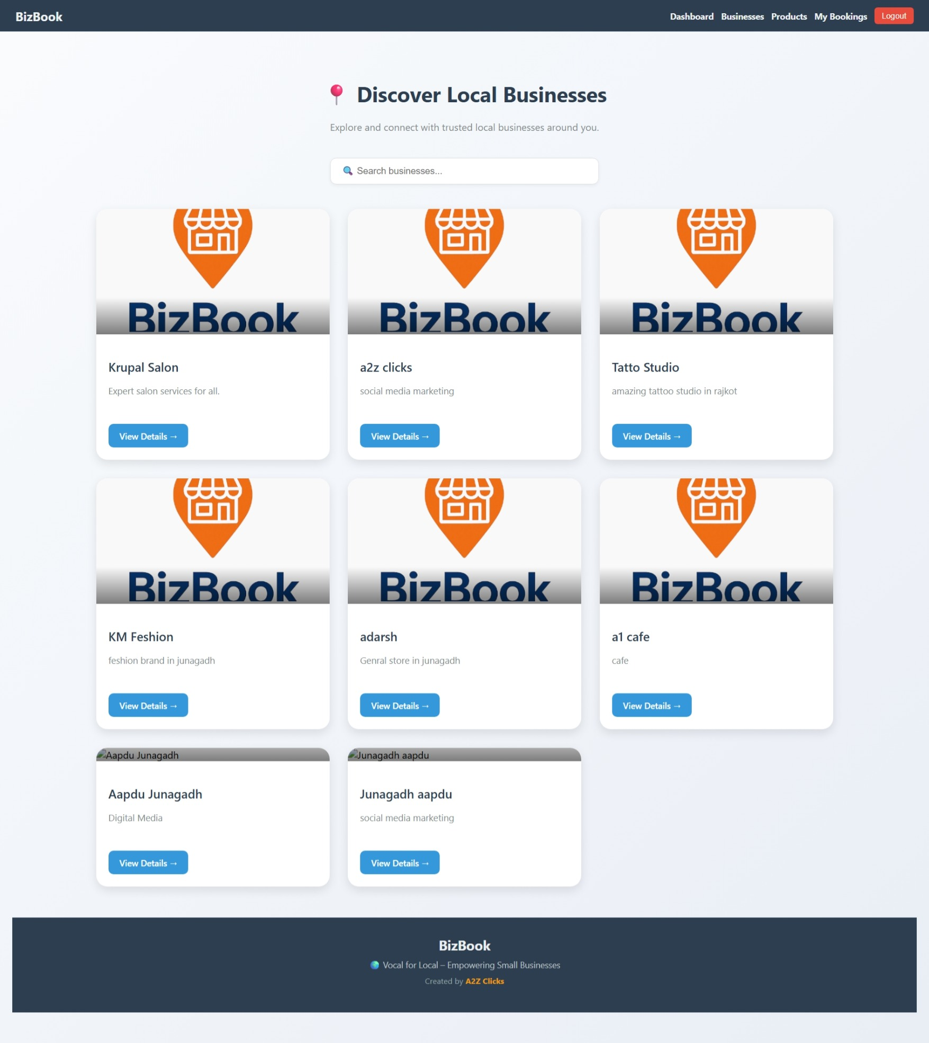
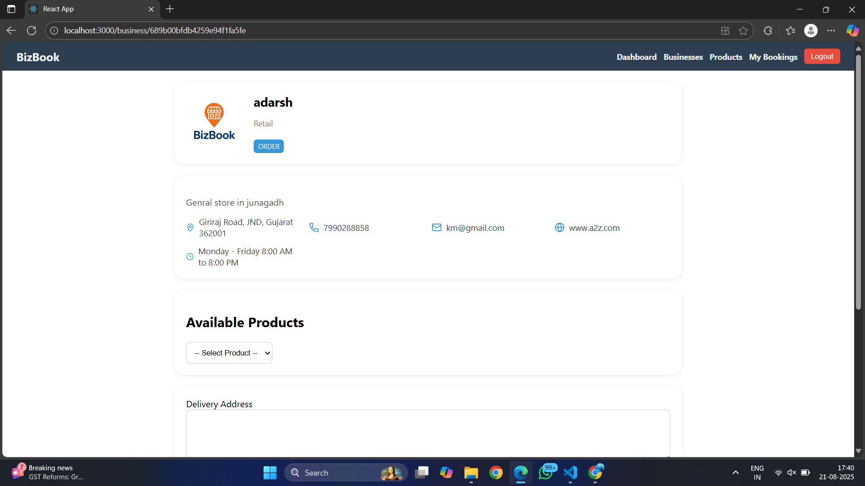
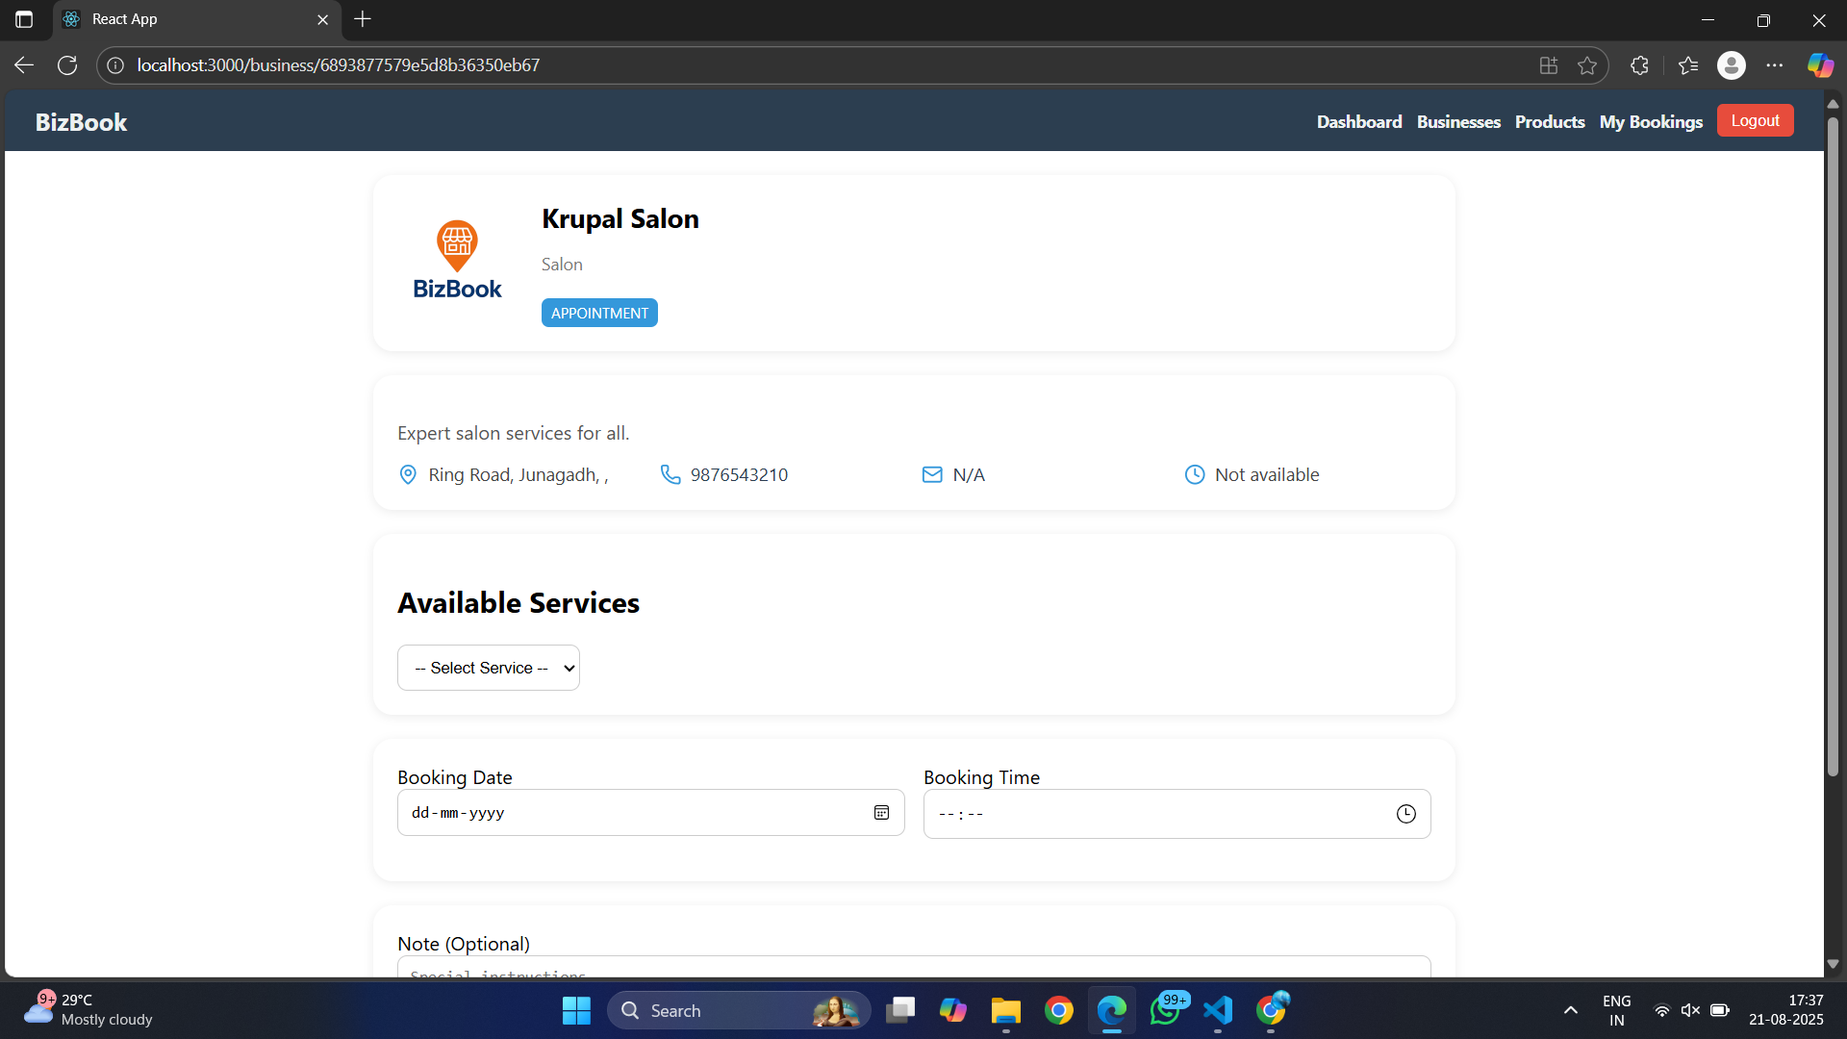
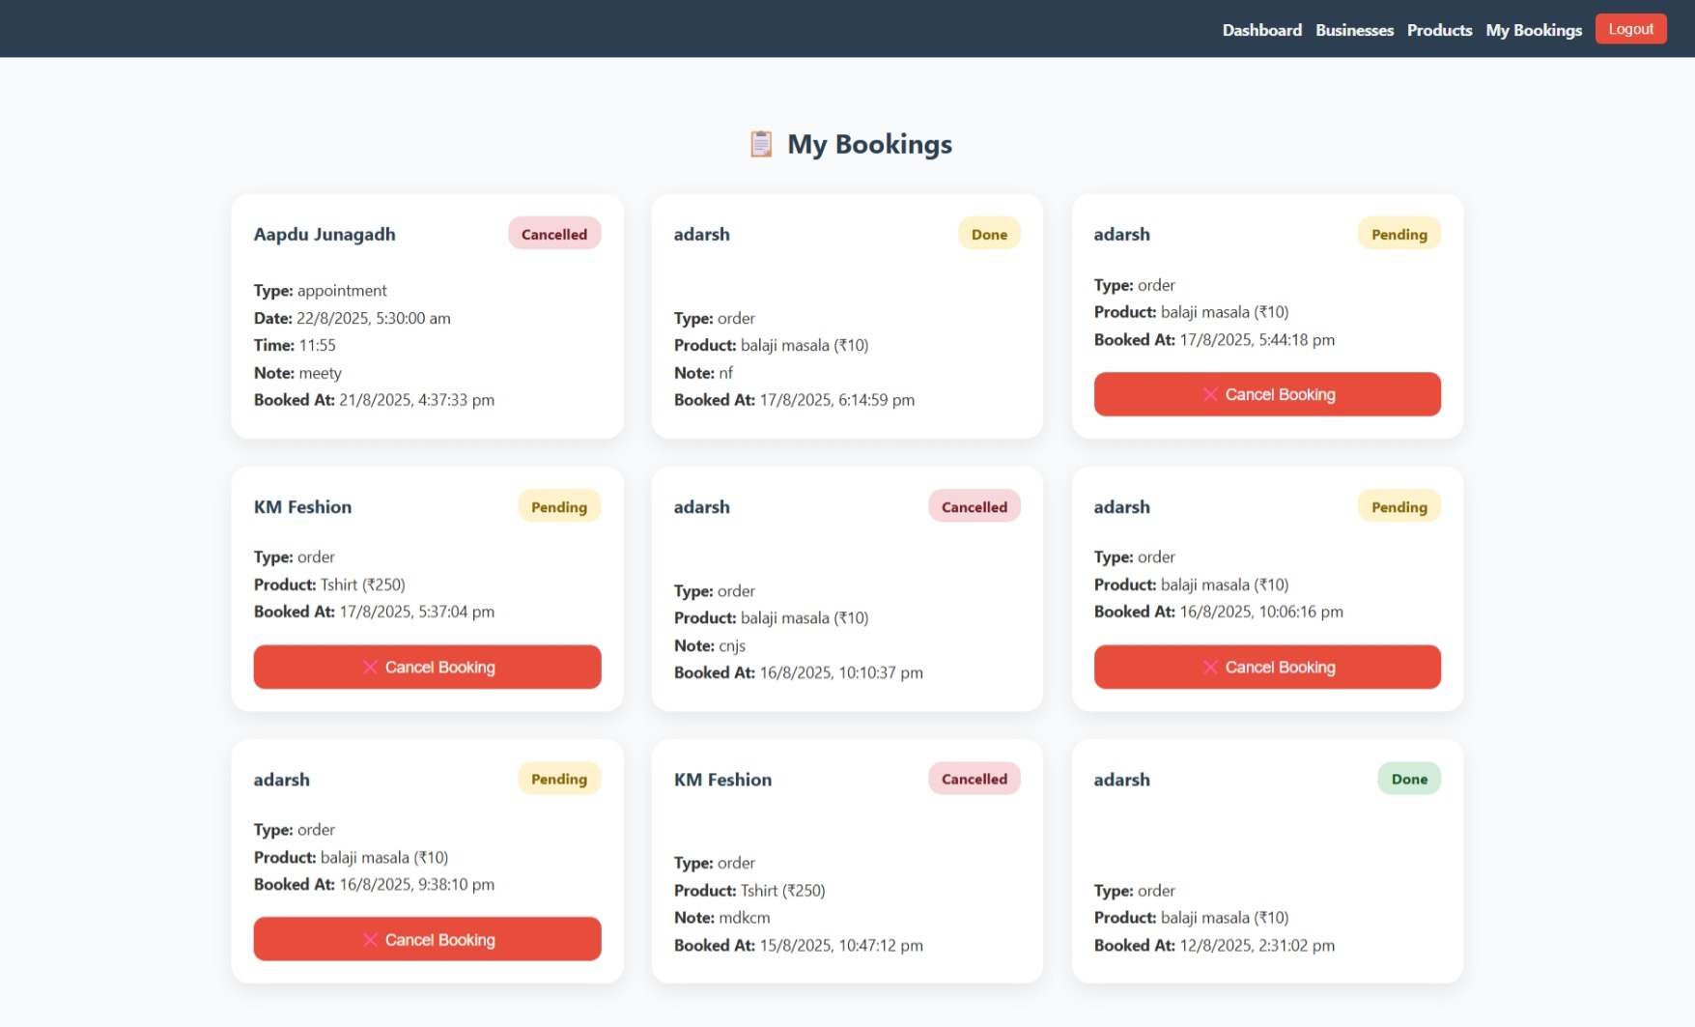
Menu Design
1. Business List
2. Business Product
3. Business Details and Book Service
4. My Bookings
15. Manage Booking

Slide 27
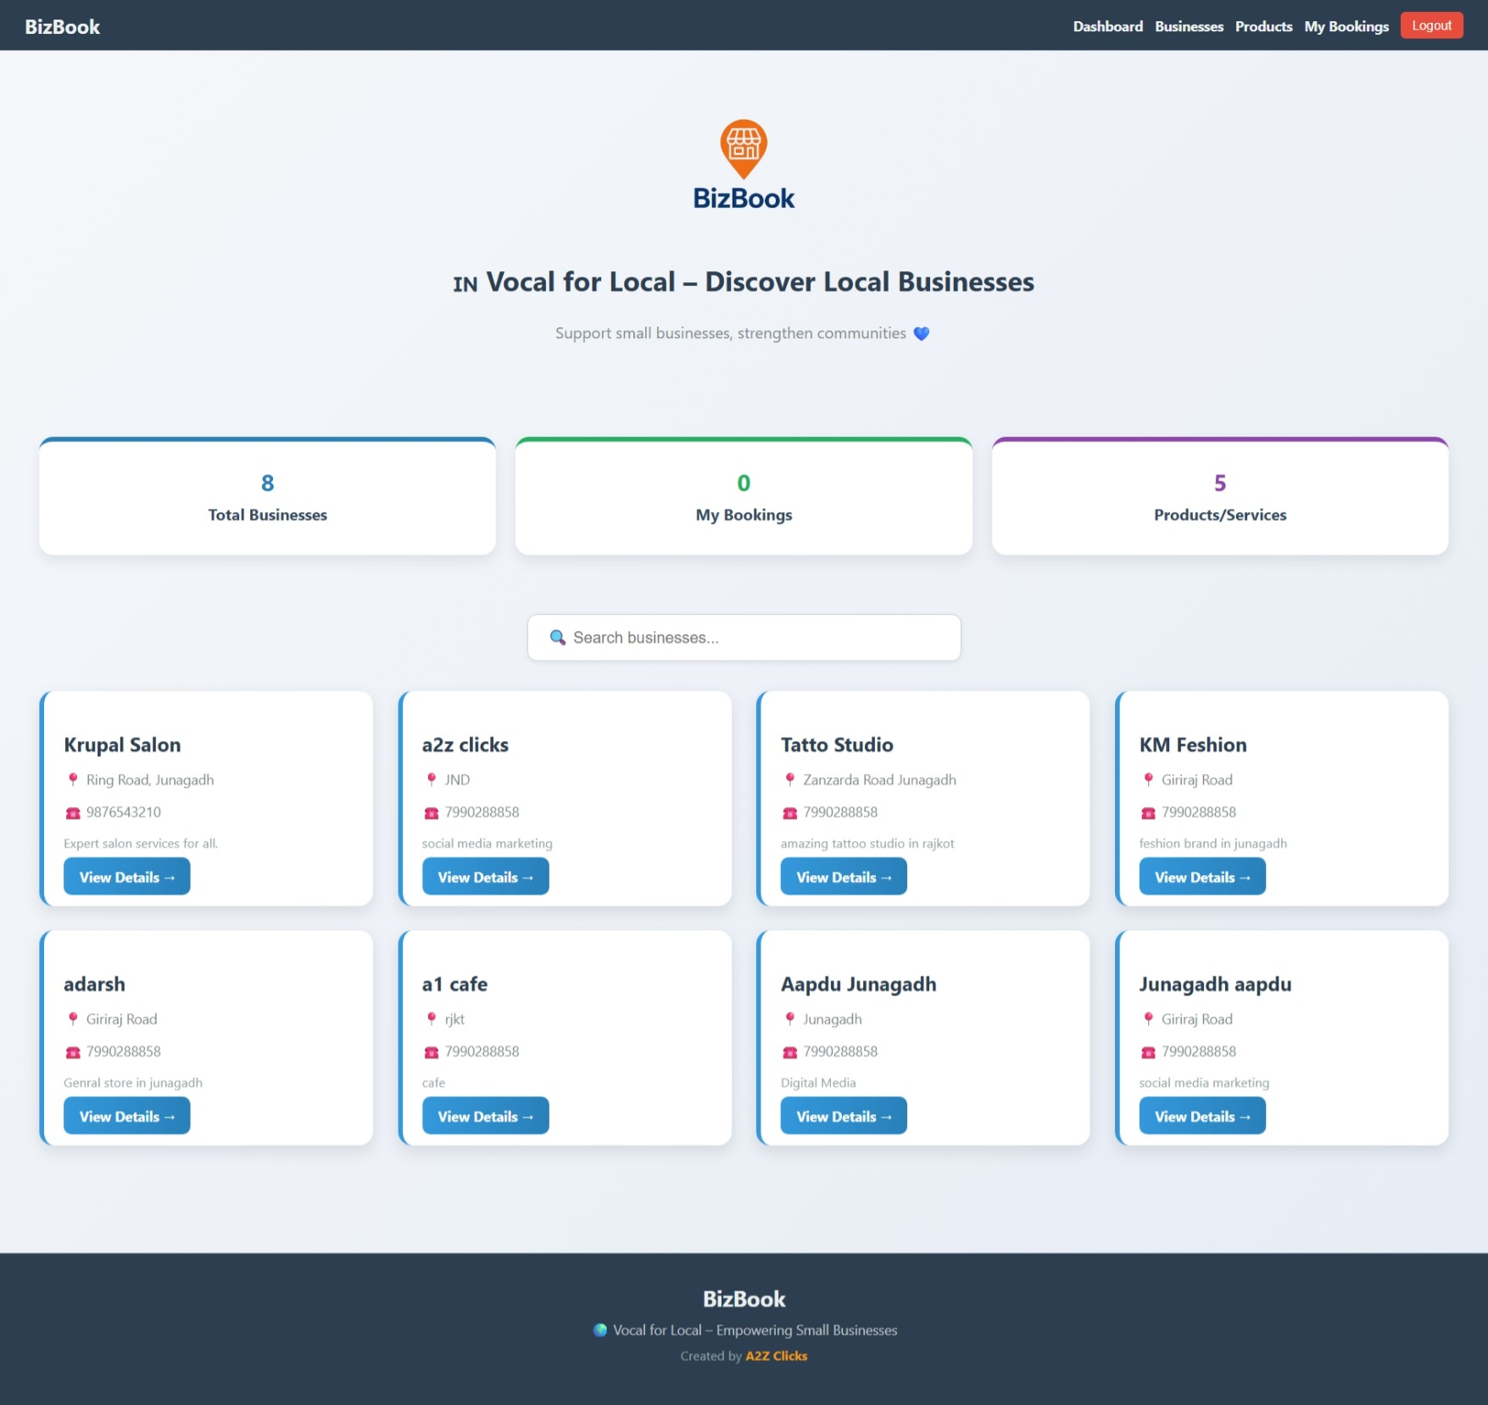
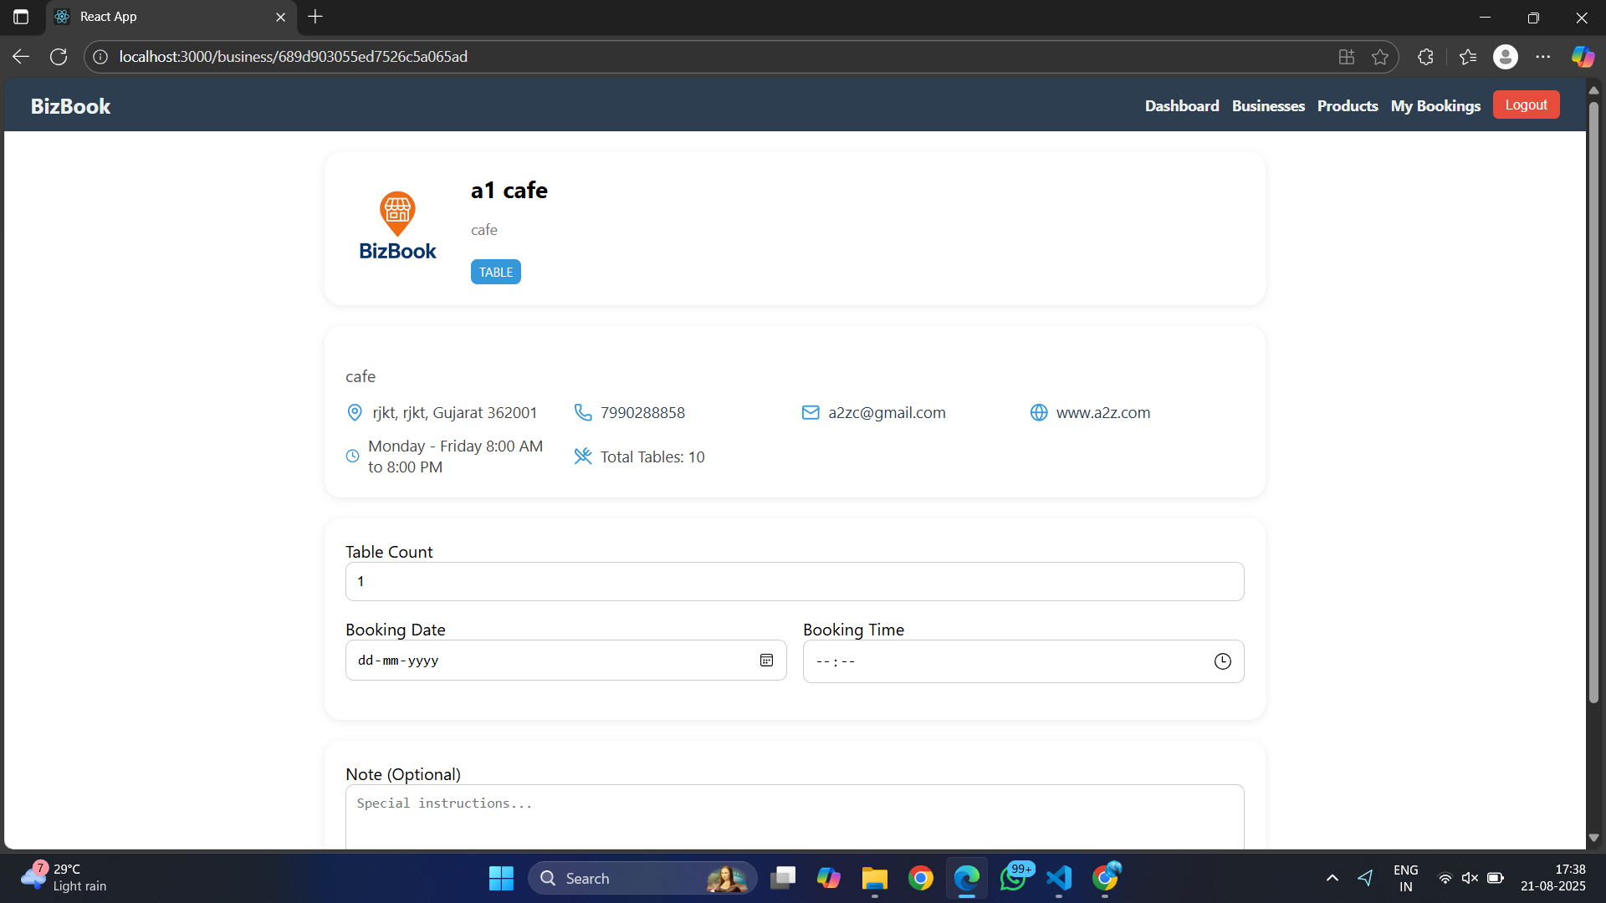
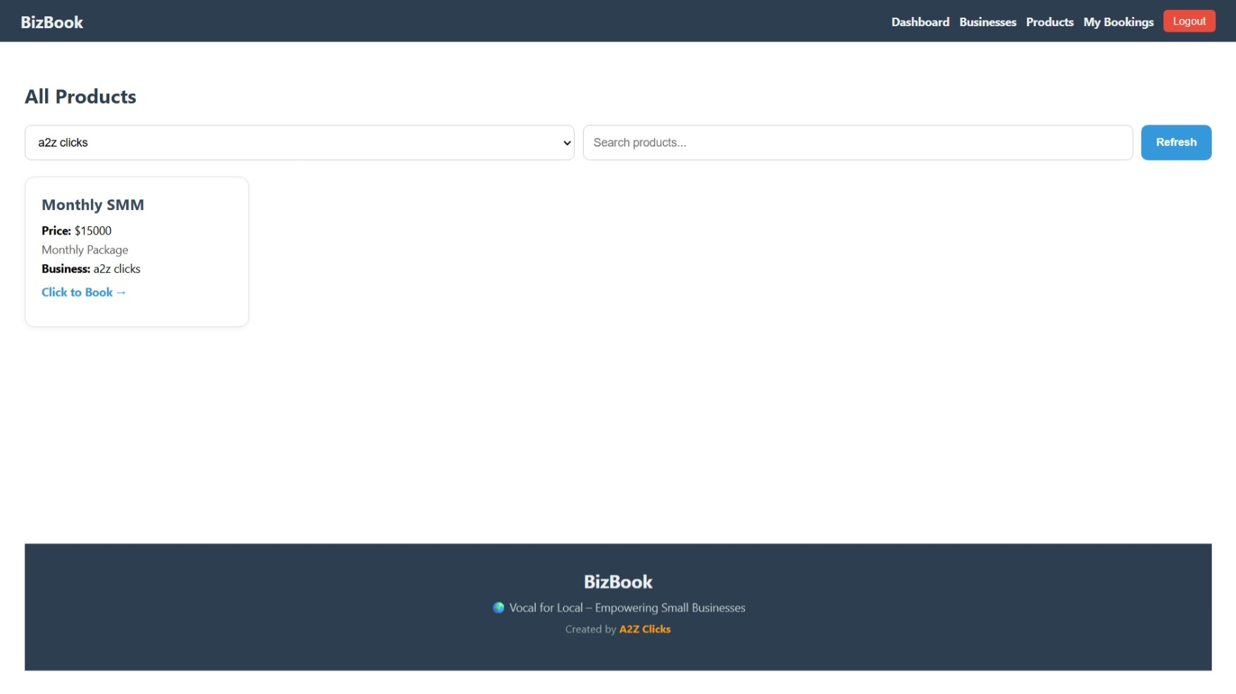
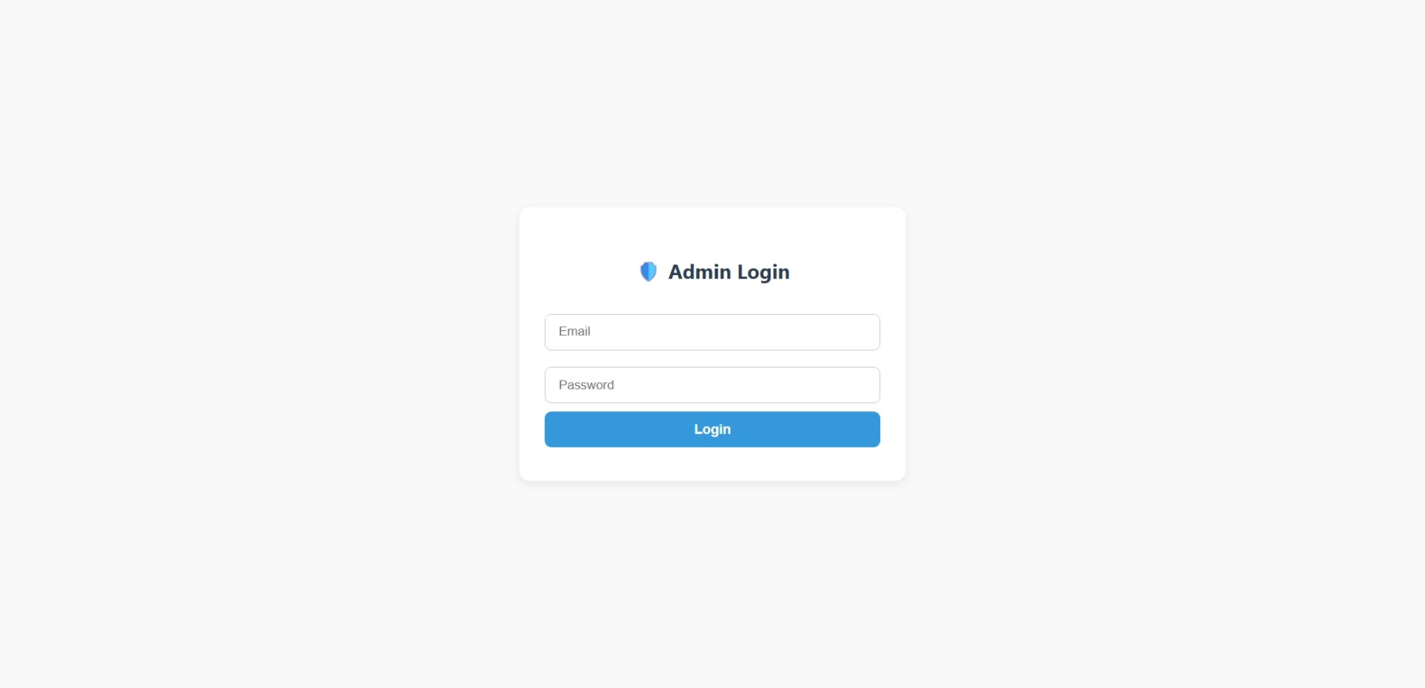
5. BizBook Dashboard
6. Business Table
7. Select Product by business
8. Admin Login

Slide 28
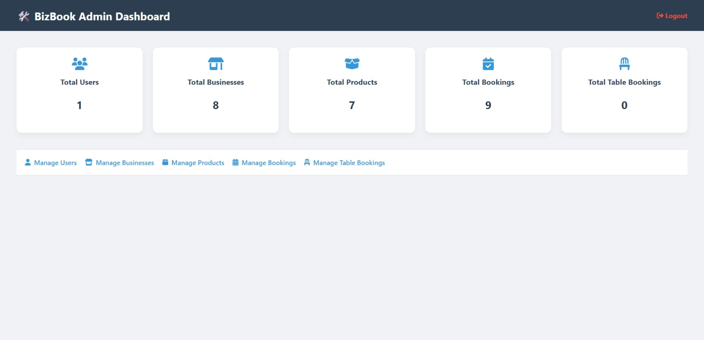
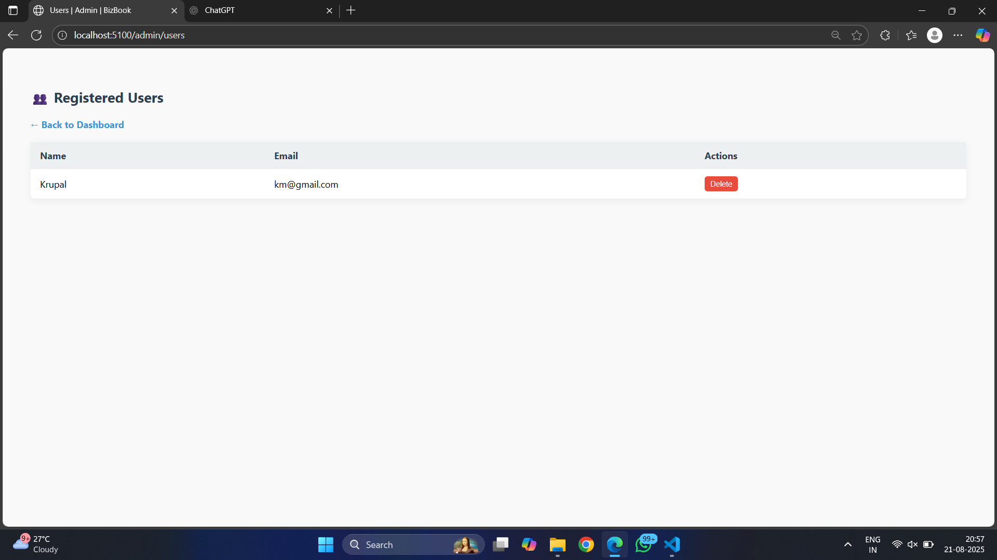
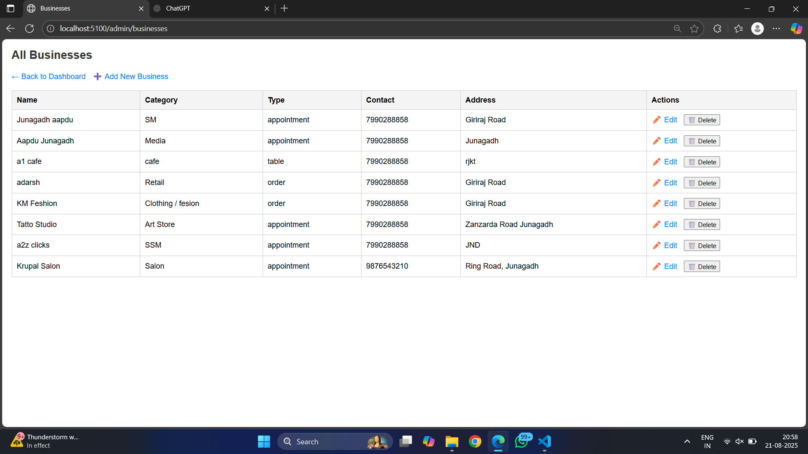
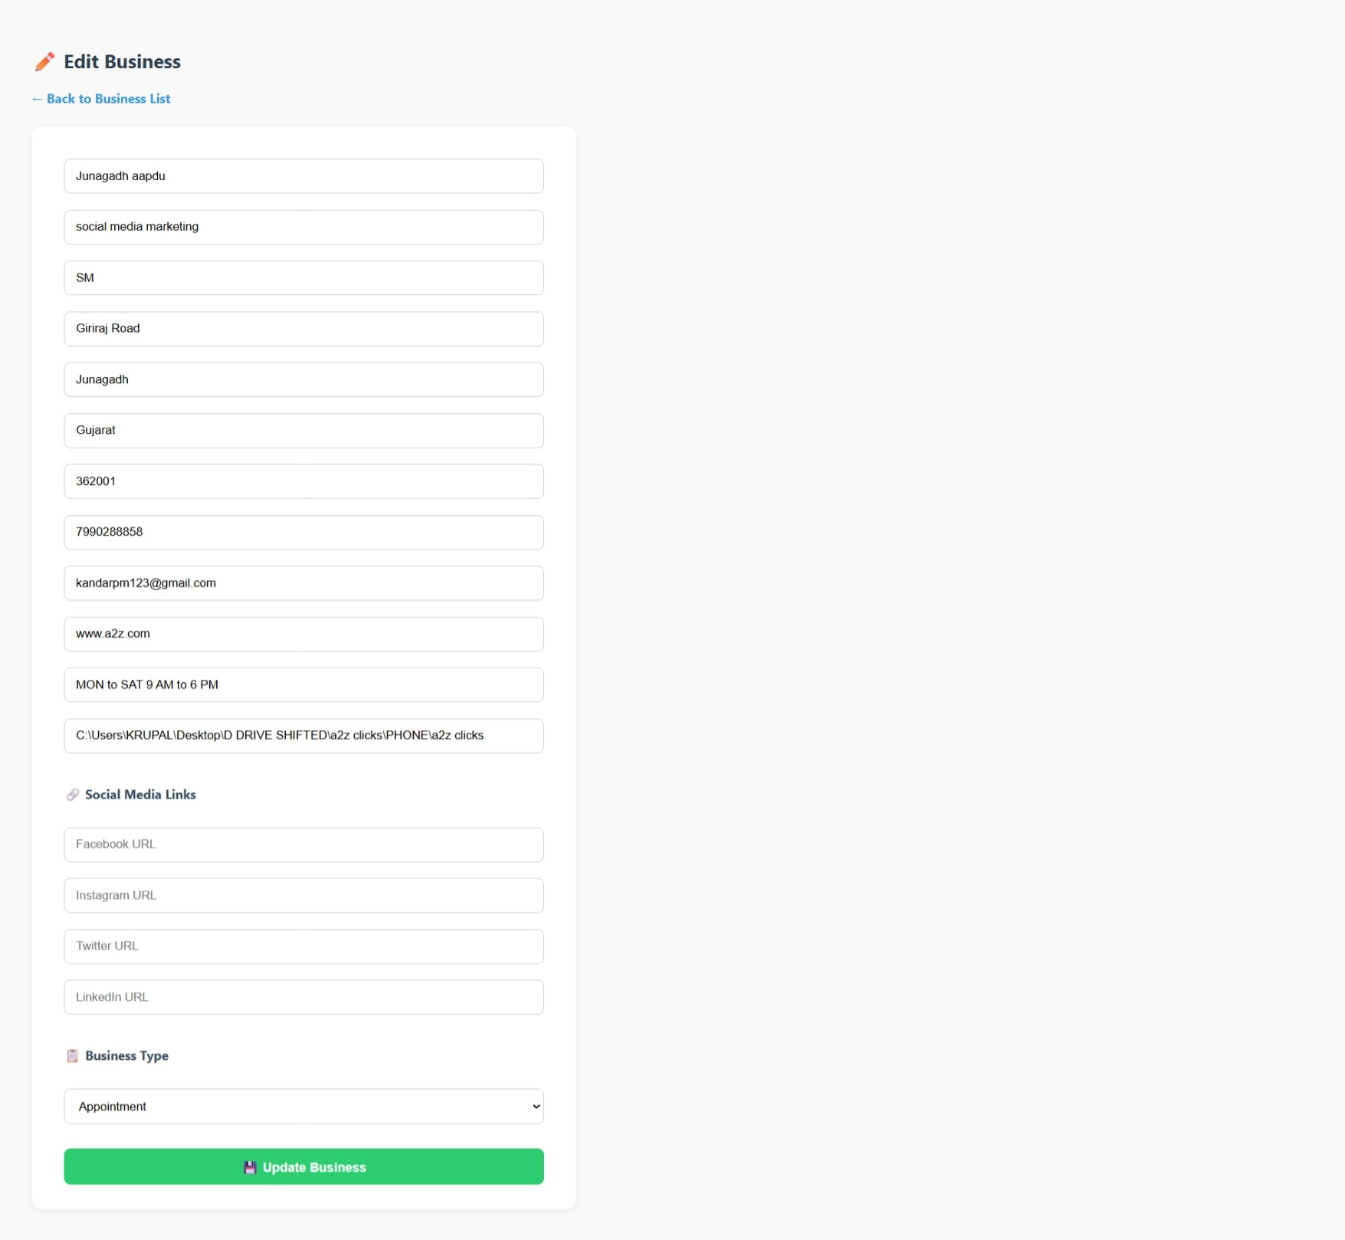
9. Admin Home page
10. Admin Manage User
11. Manage Business List
12. Edit Business

Slide 29
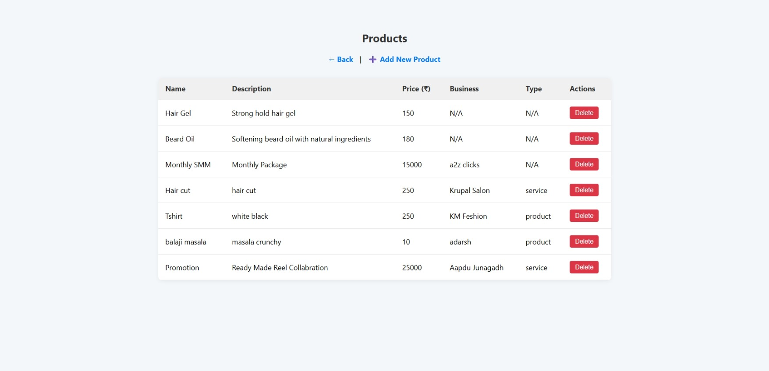
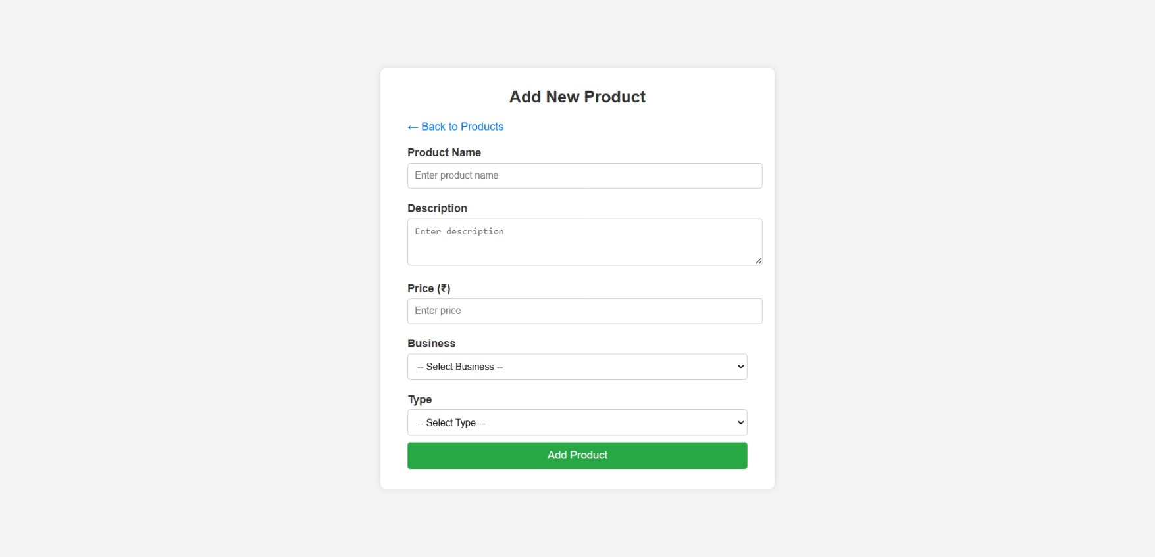
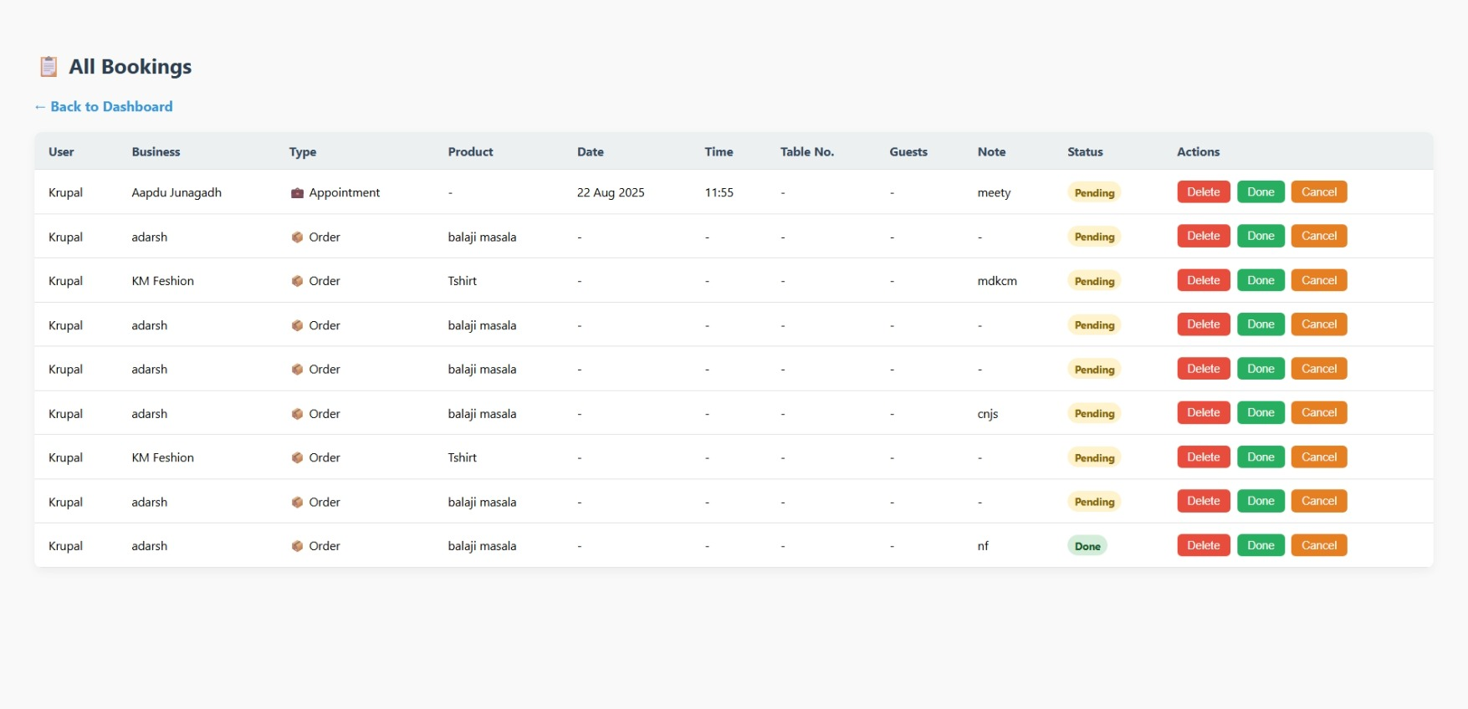
13. Product List
14. Add New Product
15. Manage Booking

Slide 30
Screen Design :
1. Landing Page (Public Home)
Purpose: Showcase all businesses with basic filters.
Elements:
Top navbar with login/register
Business cards (name, category, location, CTA: “View Details”)
Search bar (by name/category)
2. User Authentication Pages
➤ Login Page
Fields: Email, Password
Button: Login
Link: “New user? Register now”
➤ Register Page
Fields: Name, Email, Phone, Password
Button: Register
Link: “Already have an account? Login”
3. Business Details Page
Purpose: Show business info + products/services + booking options
Elements:
Business name, address, contact
Category badge (e.g., "Salon" / "Retail")
Products/Services list (name, price, description)
Booking form:
For appointment/table: date & time picker
For order: one-click confirm
4. Book Appointment Page
Fields:
Auto-filled: Business, Product
Input: Date, Time
Button: Confirm Booking
5. My Bookings Page
List of user’s bookings
Shows:
Business name
Product/service
Date, Time, Type
Status (Pending/Confirmed)
6. Admin Panel (EJS UI)
Admin Login Page
Dashboard
Total Users, Bookings, Businesses, Products
Business Management
List, Add, Edit, Delete
Product Management
Linked to businesses
User Management
View all registered users
Booking Management
View bookings with filters

Slide 31

06
SYSTEM TESTING

Slide 32
Authentication (User & Admin)
Test Scenario | Prompt
Register New User | Register a new user with valid credentials.
Duplicate Registration | Attempt to register with an already registered email.
Successful User Login | Login as user with correct email and password.
Failed Login | Try to login with incorrect password.
Admin Login | Login as admin with correct credentials.
Unauthorized Access | Access a protected route without token.

Slide 33
Business Management
Test Scenario | Prompt
Add New Business (Admin) | Add a new business with all required details as admin.
Get All Businesses (User) | Fetch all available businesses as a user.
Get Single Business | Fetch a single business by its ID.
Invalid Business ID | Attempt to fetch a business using an invalid ID.
Unauthorized Add Attempt | Try to add a business as a non-admin user.

Slide 34
Product/Service Management
Test Scenario | Prompt
Add Product/Service (Admin) | Add a product linked to a business (FK) as admin.
Get Products for Business | Fetch all products for a specific business.
Product Without Business FK | Attempt to add a product without linking to a business.
Incomplete Product Submission | Try to add a service/product with missing fields.

Slide 35
Booking System
Test Scenario | Prompt
Book Appointment (Salon) | Book an appointment for a salon-type business.
Book Table (Restaurant) | Book a table for a restaurant-type business.
Order Product (Retail) | Place a product order for a retail-type business.
Double Booking Attempt | Attempt to book at an already booked time slot.
Invalid Booking Type | Submit a booking request with an invalid type.

Slide 36
User Booking History
Test Scenario | Prompt
View User Bookings | View all bookings made by the logged-in user.
Booking Confirmation | View booking confirmation message after booking.
Unauthorized Booking Access | Try to view bookings without logging in.

Slide 37
Admin Dashboard Testing
Test Scenario | Prompt
View All Businesses (Admin) | Login as admin and view list of all businesses.
View All Bookings | View all bookings made by users.
Add Business Category | Add a category and assign it to a business.
Delete Business (Cascade) | Delete a business and check cascade delete (if any).
Unauthorized Admin Action | Attempt admin action with a normal user token.

Slide 38
07
CONCLUSION

Slide 39



CONCLUSION
The BizBook Project successfully integrates a complete business booking and management system using Node.js, Express, MongoDB, and EJS. It provides a role-based platform where:
Users can register, log in, and easily make table bookings, product orders, or appointments.
Business Owners can manage their own business profiles, products, and bookings through a secure dashboard.
Admins can oversee the entire system, update booking statuses, and manage businesses through an EJS-based admin panel.
The project uses a hybrid authentication system:
JWT tokens secure API routes for mobile apps and external clients.
Session-based authentication secures the web dashboards for admin, owners, and users.
With its modular design (separate models, controllers, and middleware), the system is scalable, secure, and easy to extend.
In the future, features like payment integration, notifications, and analytics can be added without major changes.
In short, this project demonstrates how a single system can serve both API consumers and web dashboard users, making it flexible and practical for real-world business solutions.

Slide 40

08
LEARNING DURING PROJECT WORK

Slide 41


LEARNING DURING PROJECT WORK
Backend Development: Learned how to use Node.js and Express for creating REST APIs and handling different routes.
Database Handling: Understood how to design and manage collections in MongoDB, including relationships between users, businesses, and bookings.
Authentication: Implemented both JWT-based authentication for APIs and session-based authentication for web dashboards, which gave hands-on experience with security.
Role Management: Learned how to separate features for Admin, Business Owner, and User, ensuring that each role gets the right access.
Error Handling: Understood the importance of validating data and handling errors properly so the system works smoothly.
Teamwork & Documentation: Improved communication, documentation skills, and ability to work on a large project step by step.

Slide 42
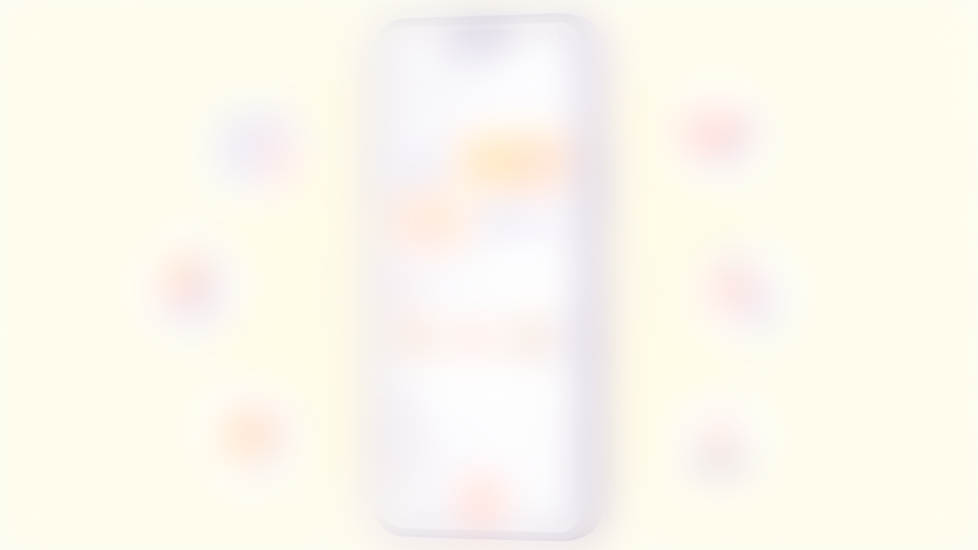
Future Enhancement
1
Payment Gateway Integration: Allow users to pay for bookings/orders online using UPI, cards, or wallets.
2
Notification System: Add email/SMS/WhatsApp alerts to inform users about booking confirmations or updates.
3
Analytics Dashboard: Provide owners and admins with reports about sales, bookings, and customer trends.
4
Mobile Application: Extend the system with a mobile app for Android/iOS using the same APIs.
5
Reviews & Ratings: Allow customers to give feedback on businesses and services.
6
Multi-language Support: Make the platform usable by people from different regions.
These enhancements will make the system more user-friendly, scalable, and practical for real business use.

Slide 43

09
BIBLIOGRAPHY

Slide 44



Online References
During the development of this project, we referred to the following online resources for learning and solving problems:
1
Official Documentation
2
Tutorials & Guides
• Node.js: https://nodejs.org
• W3Schools (for JavaScript and web basics)
• Express.js: https://expressjs.com
• GeeksforGeeks (for coding concepts and examples)
• MongoDB: https://www.mongodb.com
• Stack Overflow (for troubleshooting errors and doubts)
• Medium & Dev.to Blogs (for practical implementation ideas)
These sources helped us understand backend logic, authentication, and database management.

Slide 45

Offline References
Notes and materials provided during lectures.
Reference books on Database Management Systems (DBMS) and Web Technologies.
Guidance from faculty members and discussions with classmates.

Slide 46
Thank You

